Slide 1
Gradient descent intuition
Linear regression with one variable

Slide 2
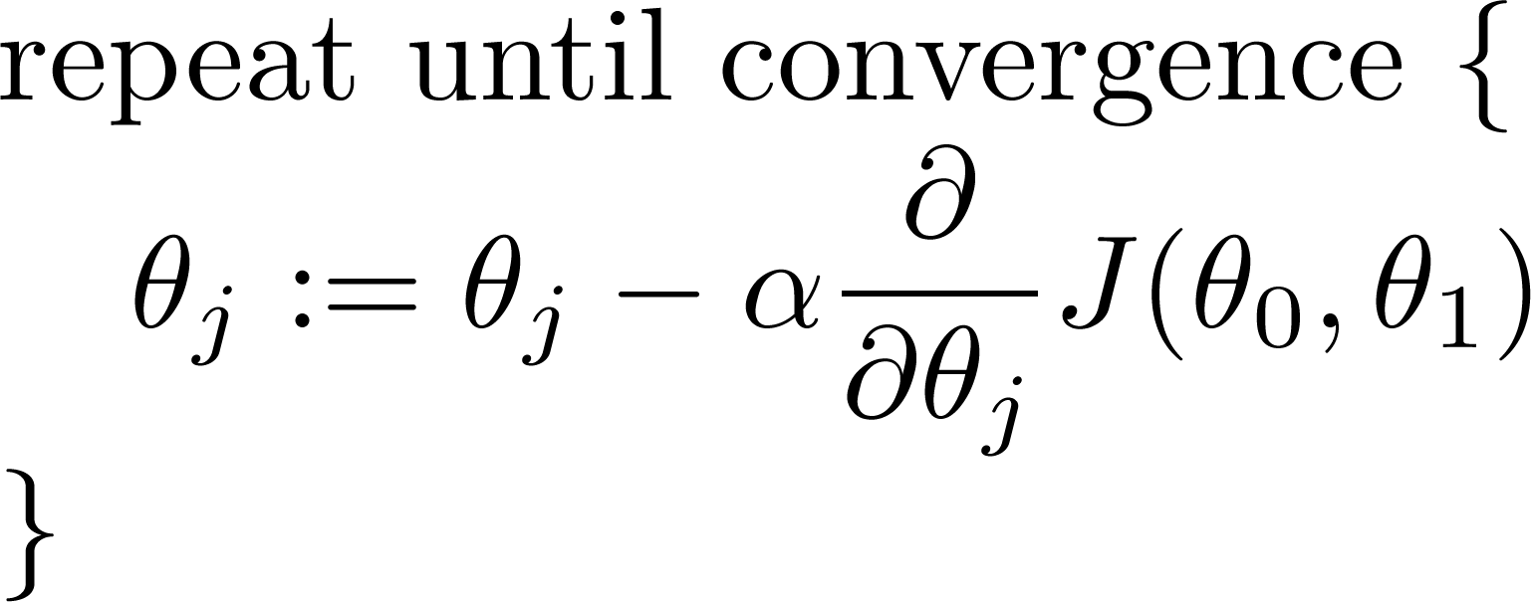
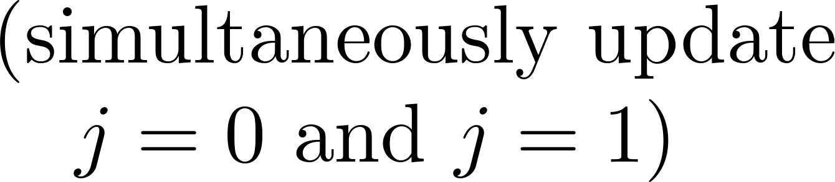
Gradient descent algorithm
Learning rate
derivative

Slide 3
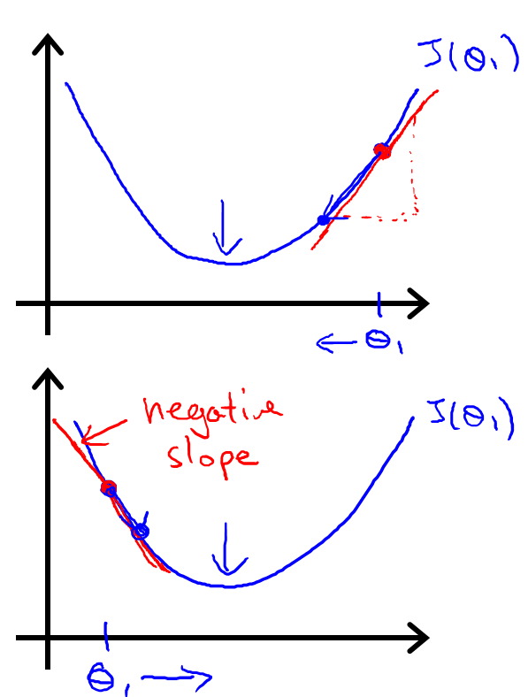






$\text{Θ}\text{1}$ := $\text{Θ}\text{1}$ - $α\frac{d}{dθ_{1}}J(θ_{1})$
$$≥0$$
$\text{Θ}\text{1}$ := $\text{Θ}\text{1}$ - $α∙J(positive number)$
$\text{Θ}\text{1}$ := $\text{Θ}\text{1}$ - $α\frac{d}{dθ_{1}}J(θ_{1})$
$$≤0$$
$\text{Θ}\text{1}$ := $\text{Θ}\text{1}$ - $α∙J(negative number)$

Slide 4
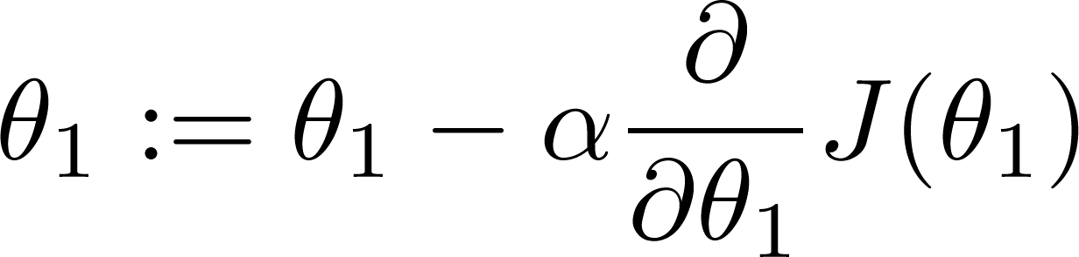

If α is too small, gradient descent can be slow.
If α is too large, gradient descent can overshoot the minimum. It may fail to converge, or even diverge.

Slide 5

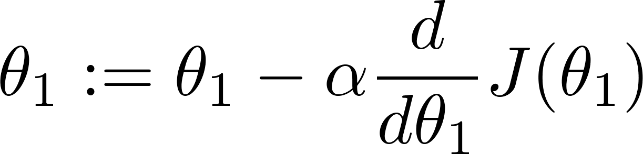
at local optima
Current value of

Slide 6

Gradient descent can converge to a local minimum, even with the learning rate α fixed.
As we approach a local minimum, gradient descent will automatically take smaller steps. So, no need to decrease α over time.

Slide 7
Gradient descent for linear regression
Linear regression with one variable

Slide 8
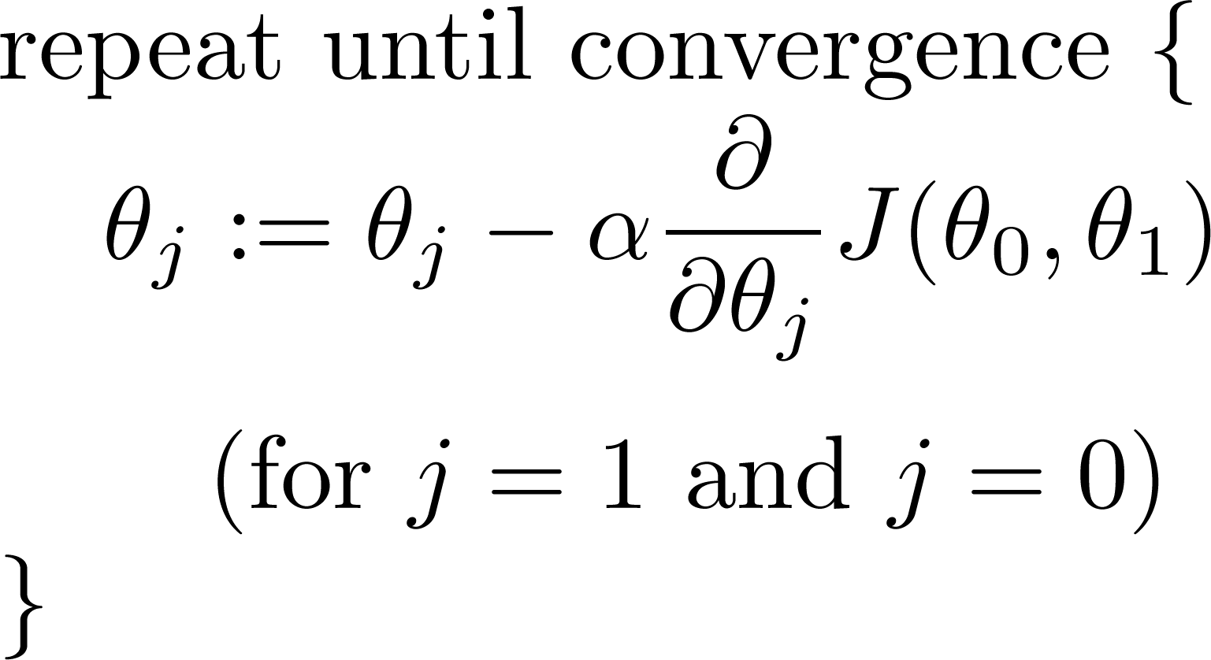
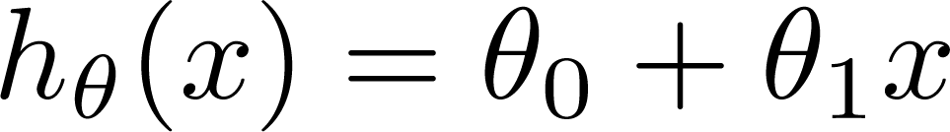
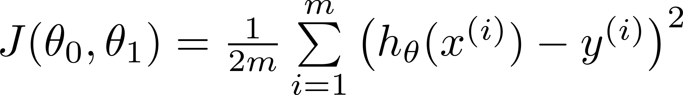
Gradient descent algorithm
Linear Regression Model

Slide 9
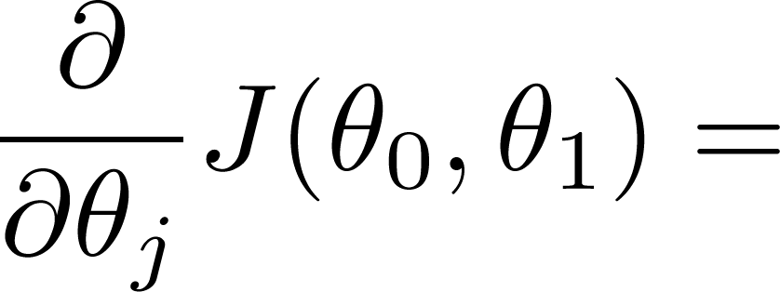
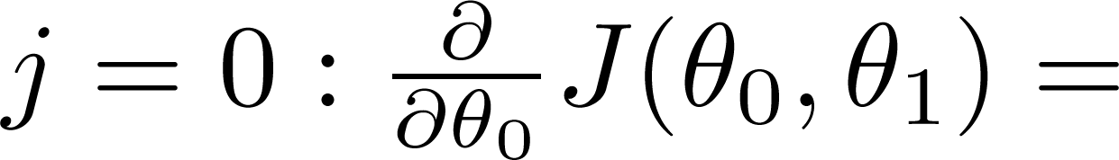
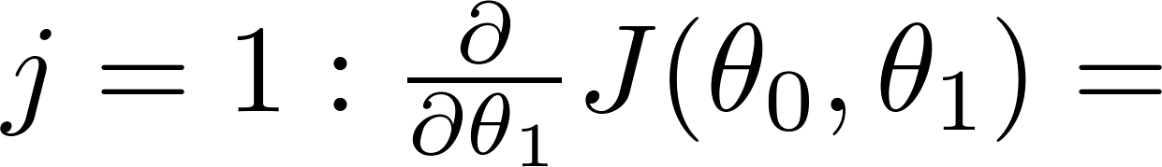
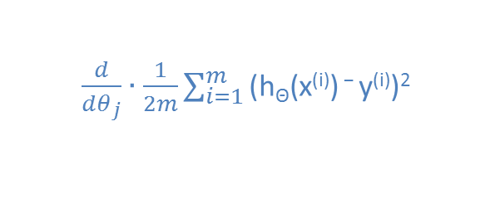
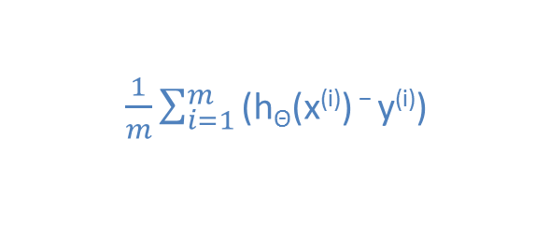
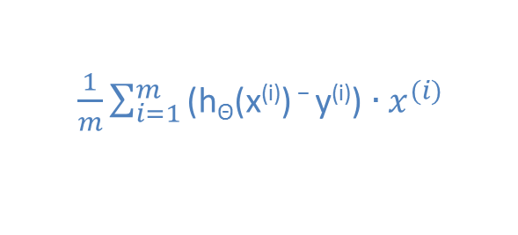
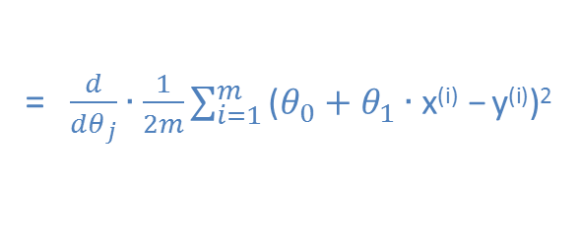
$\frac{d}{dθ_{j}}∙\frac{1}{2m}\sum_{i=1}^{m}{\text{(}\text{h}\text{Θ}\text{(}\text{x}\text{(}\text{i}\text{)) − }\text{y}\text{(}\text{i}\text{))2 }}$
= $\frac{d}{dθ_{j}}∙\frac{1}{2m}\sum_{i=1}^{m}{\text{(}θ_{0}+θ_{1}∙\text{x}\text{(}\text{i}\text{) − }\text{y}\text{(}\text{i}\text{))2 }}$
$\frac{1}{m}\sum_{i=1}^{m}{\text{(}\text{h}\text{Θ}\text{(}\text{x}\text{(}\text{i}\text{)) − }\text{y}\text{(}\text{i}\text{)) }}$
$\frac{1}{m}\sum_{i=1}^{m}{\text{(}\text{h}\text{Θ}\text{(}\text{x}\text{(}\text{i}\text{)) − }\text{y}\text{(}\text{i}\text{))}∙x^{(i)} }$

Slide 10
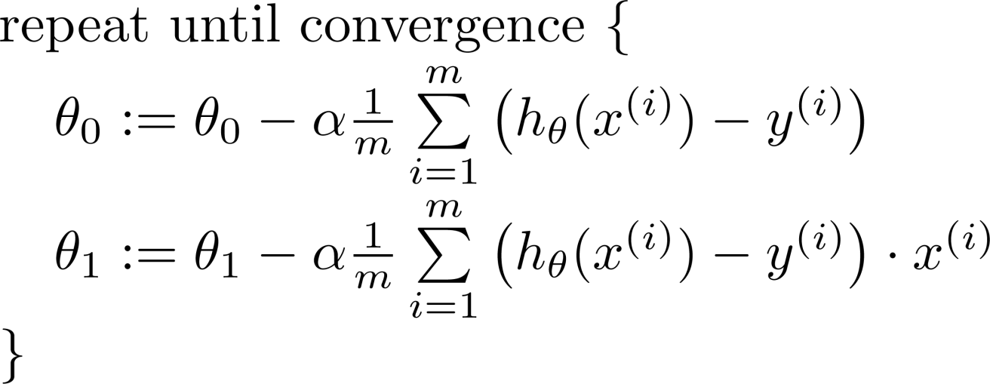



Gradient descent algorithm
$\frac{d}{dθ_{0}}∙J(θ_{0},θ_{1})$
update
and
simultaneously
$\frac{d}{dθ_{1}}∙J(θ_{0},θ_{1})$

Slide 11
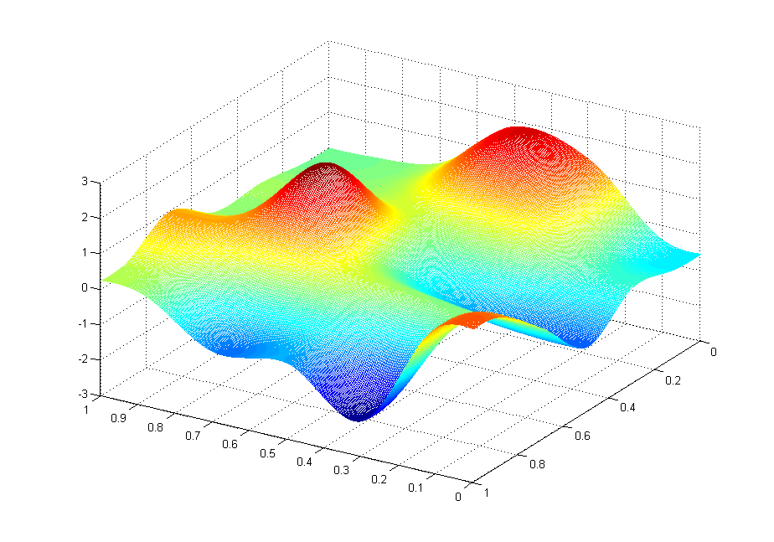
J(θ₀,θ₁)
θ₁
θ₀

Slide 12
J(θ₀,θ₁)
θ₁
θ₀

Slide 13
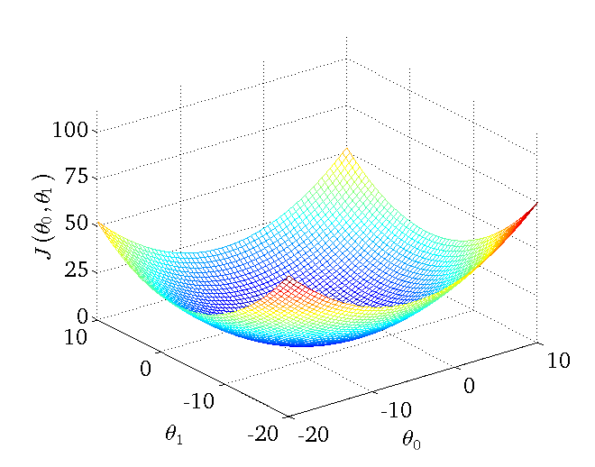
Convex function
Bowl-shaped

Slide 14

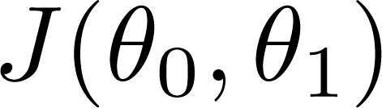


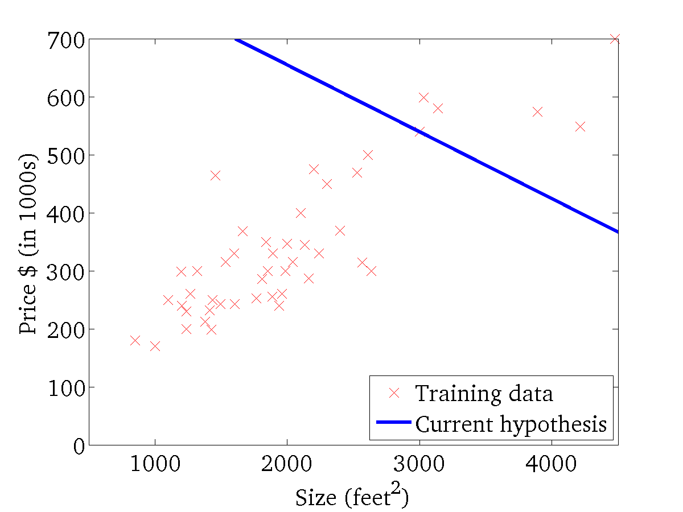
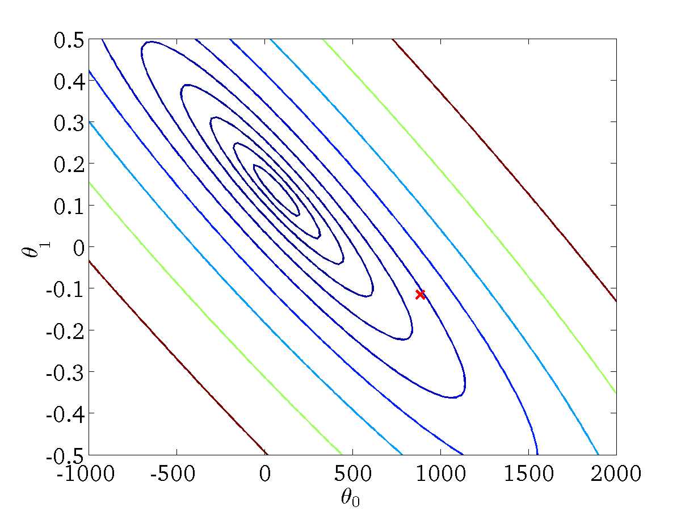
(for fixed , this is a function of x)
(function of the parameters )

Slide 15
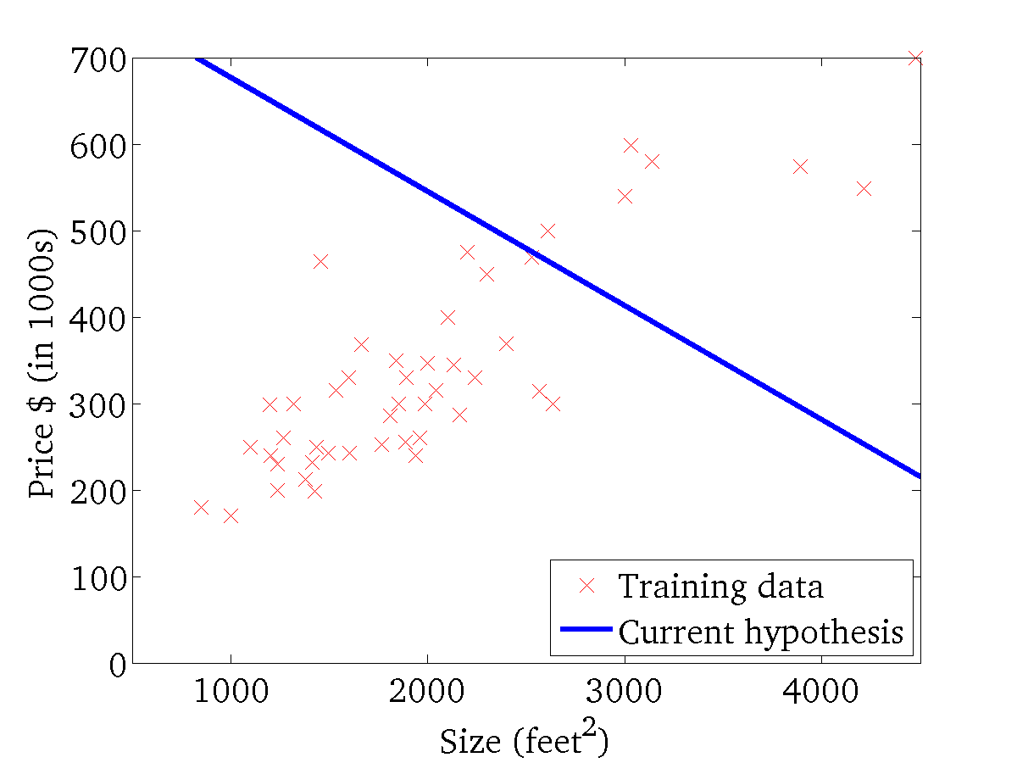

(for fixed , this is a function of x)
(function of the parameters )

Slide 16
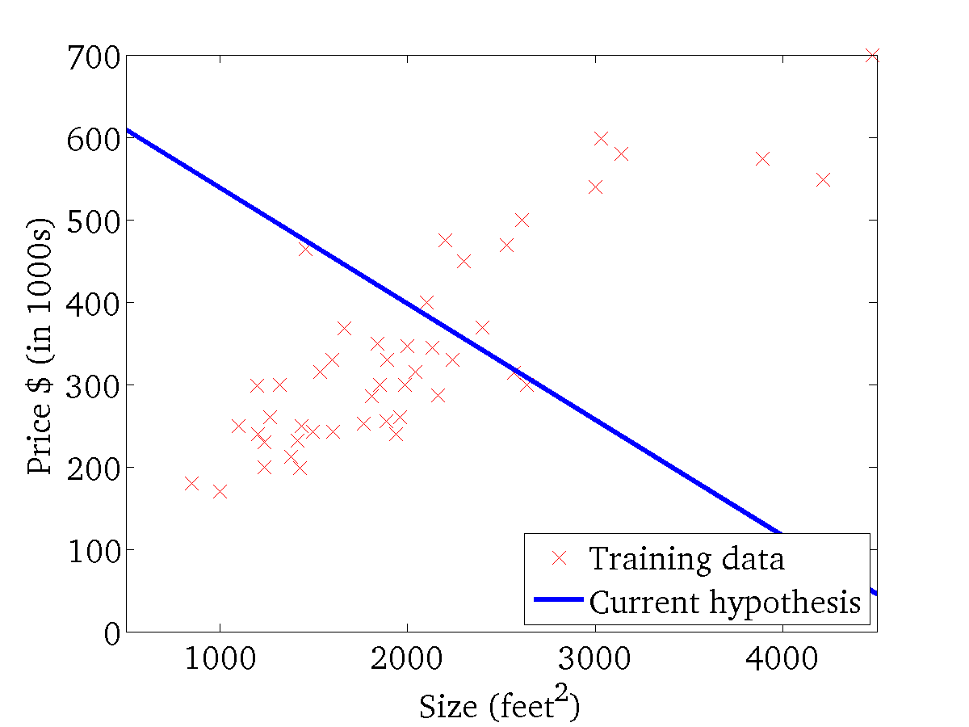
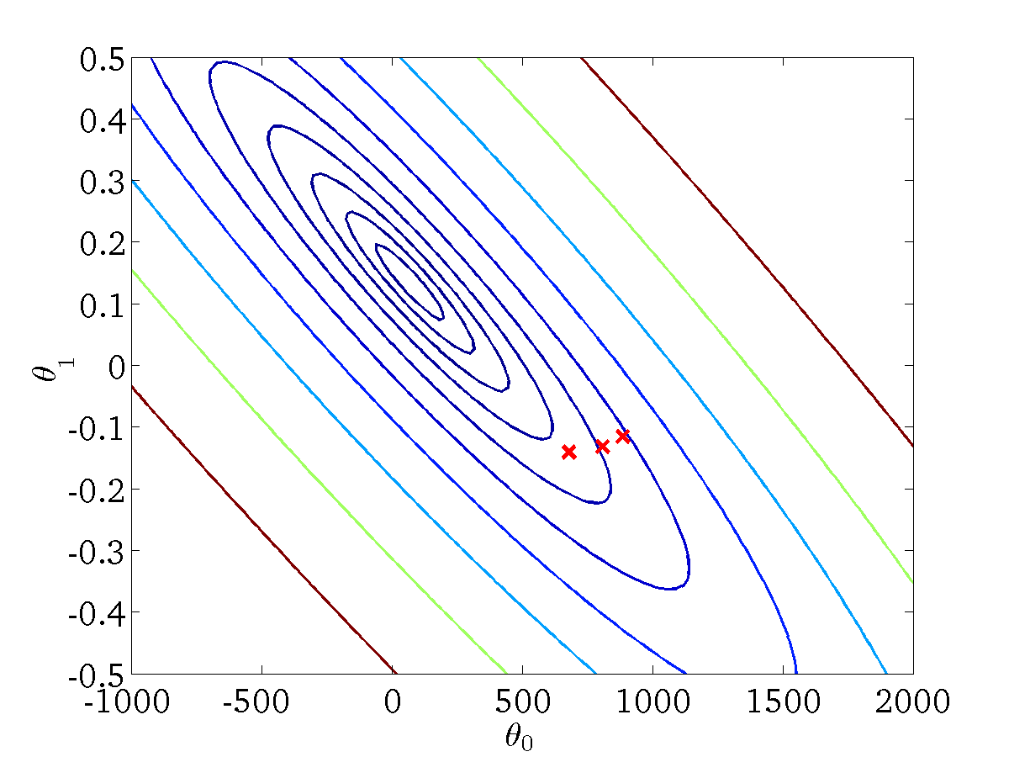
(for fixed , this is a function of x)
(function of the parameters )

Slide 17
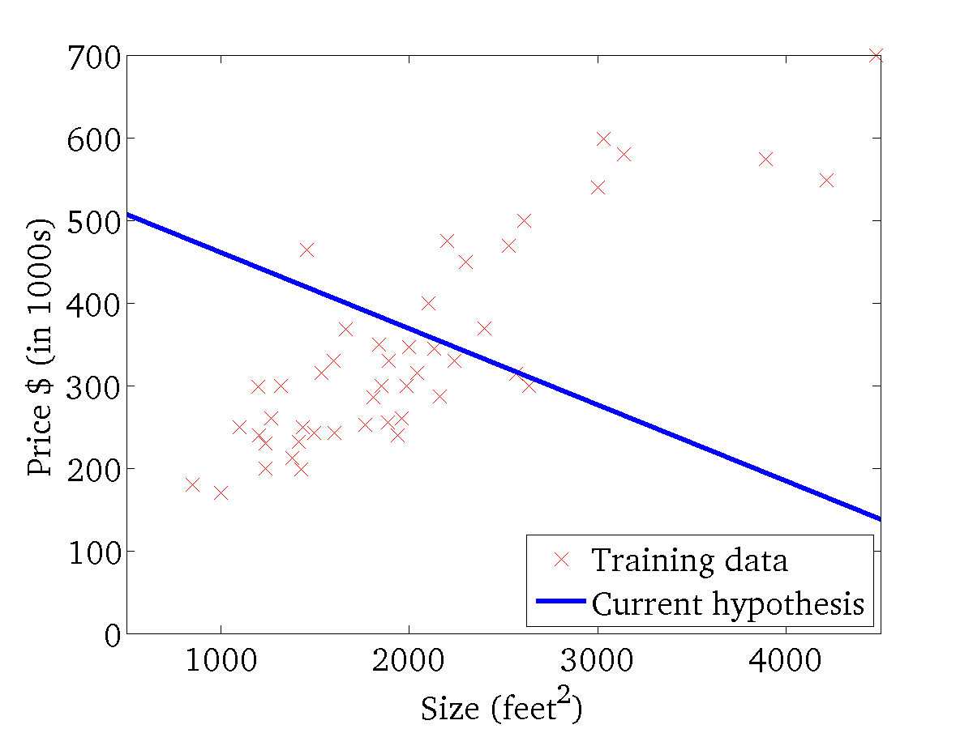

(for fixed , this is a function of x)
(function of the parameters )

Slide 18
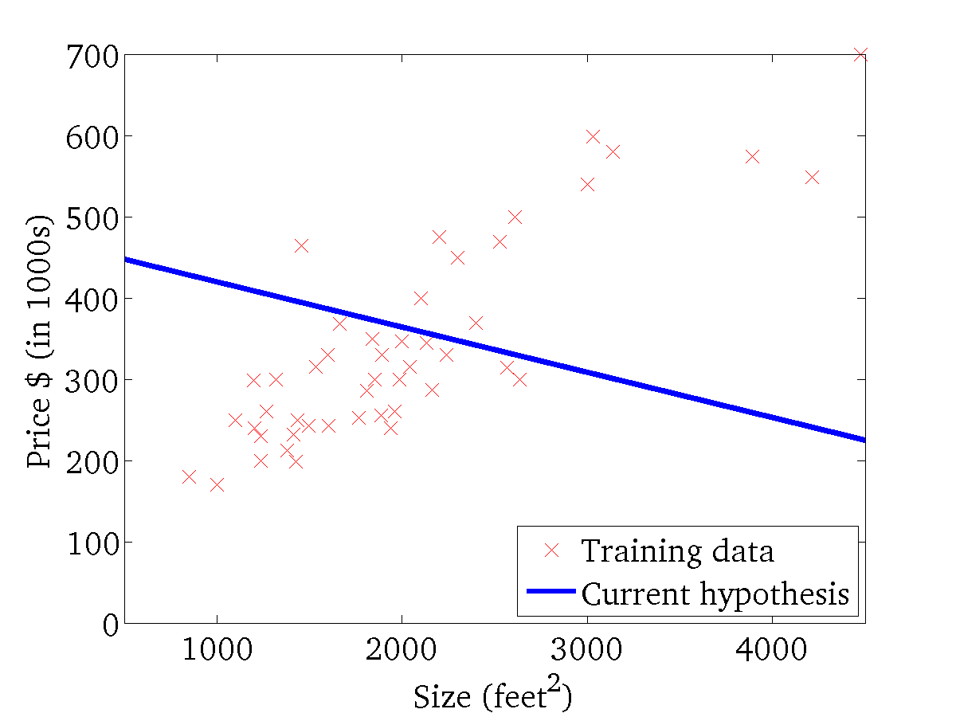
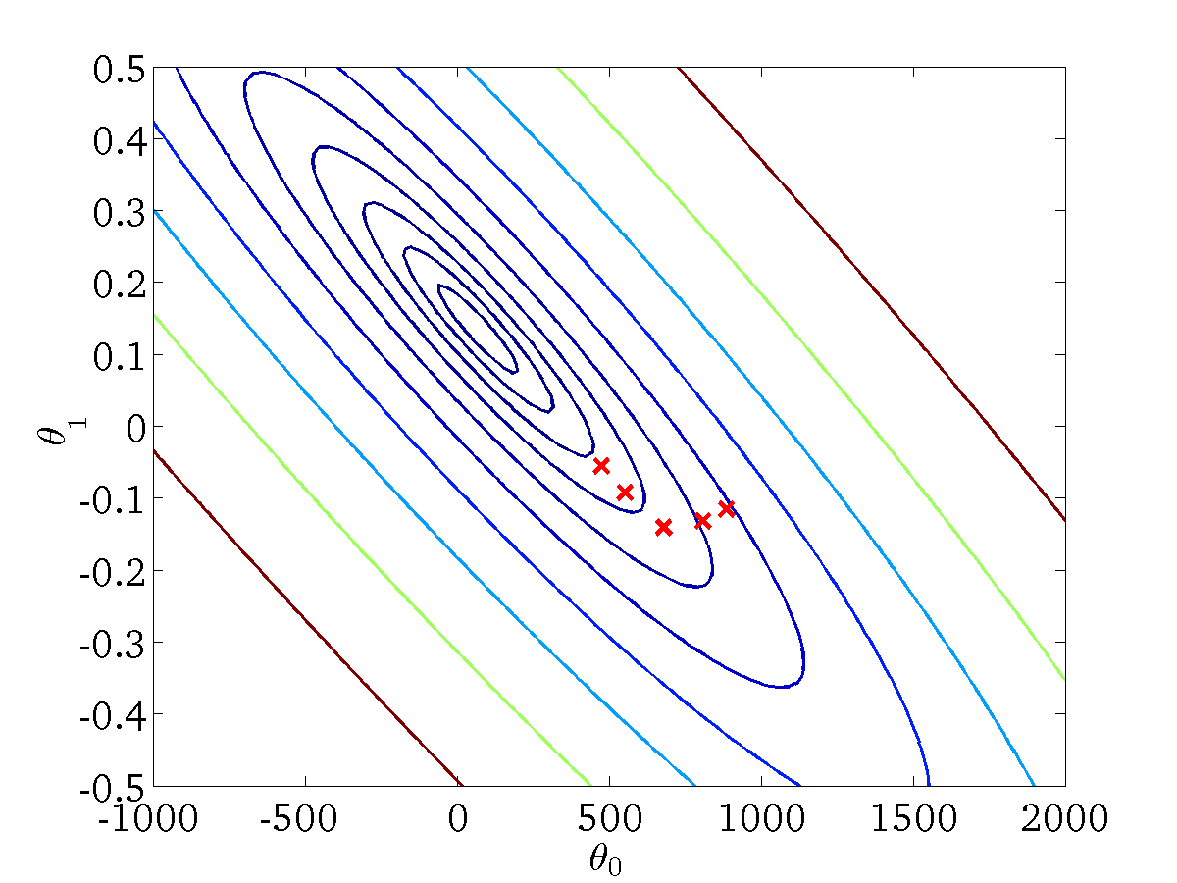
(for fixed , this is a function of x)
(function of the parameters )

Slide 19
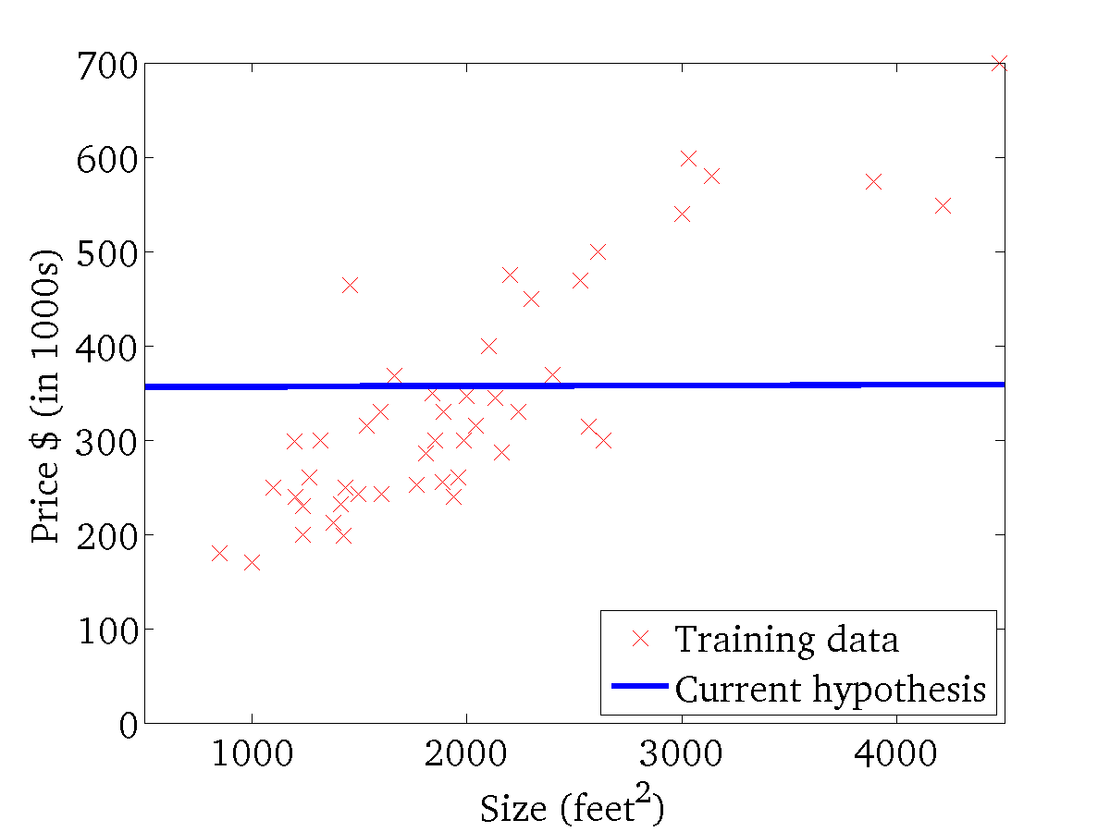

(for fixed , this is a function of x)
(function of the parameters )

Slide 20
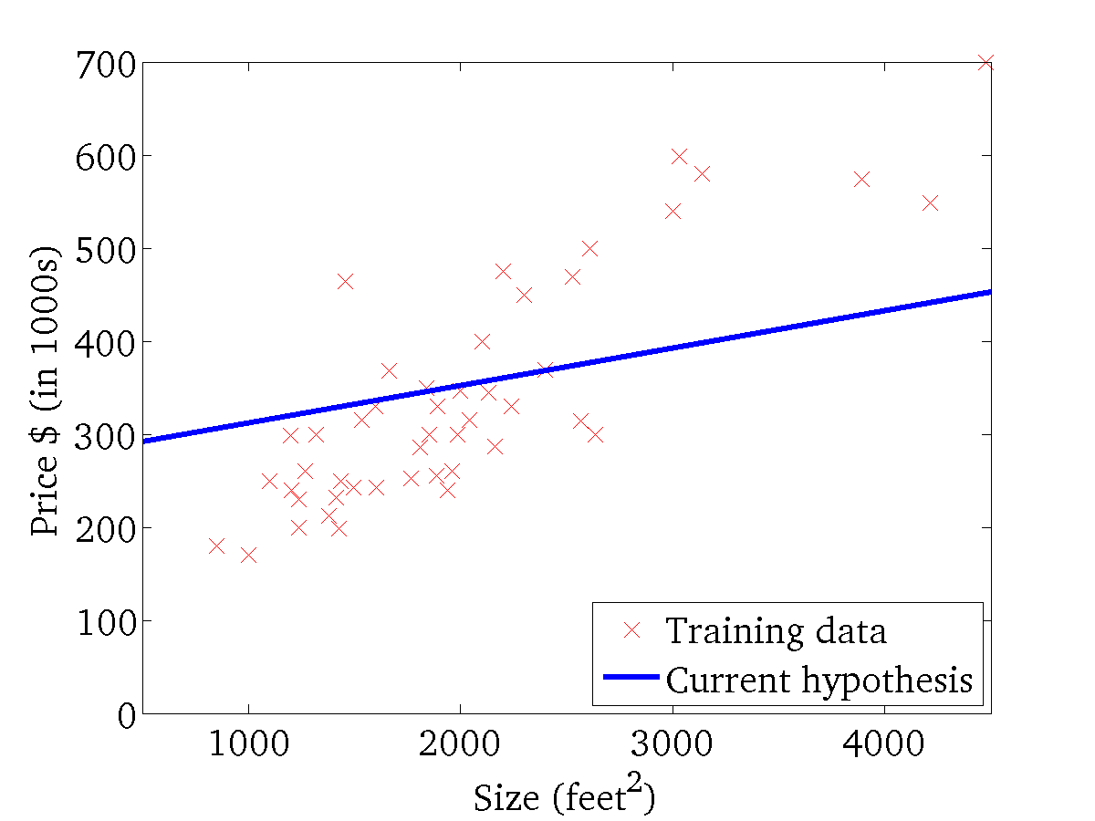

(for fixed , this is a function of x)
(function of the parameters )

Slide 21
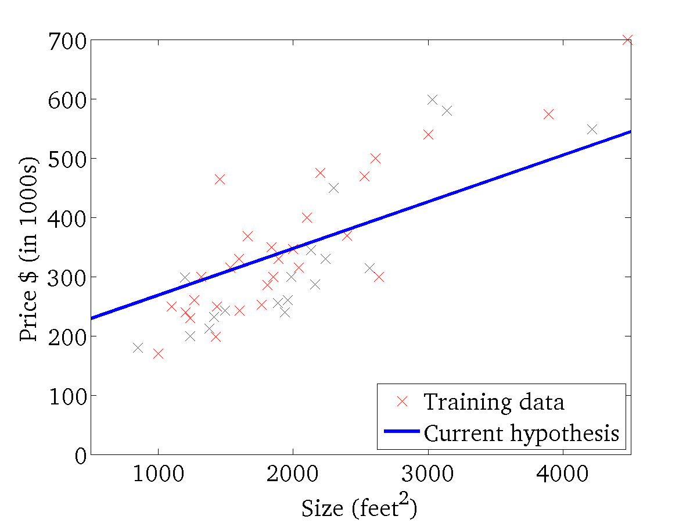
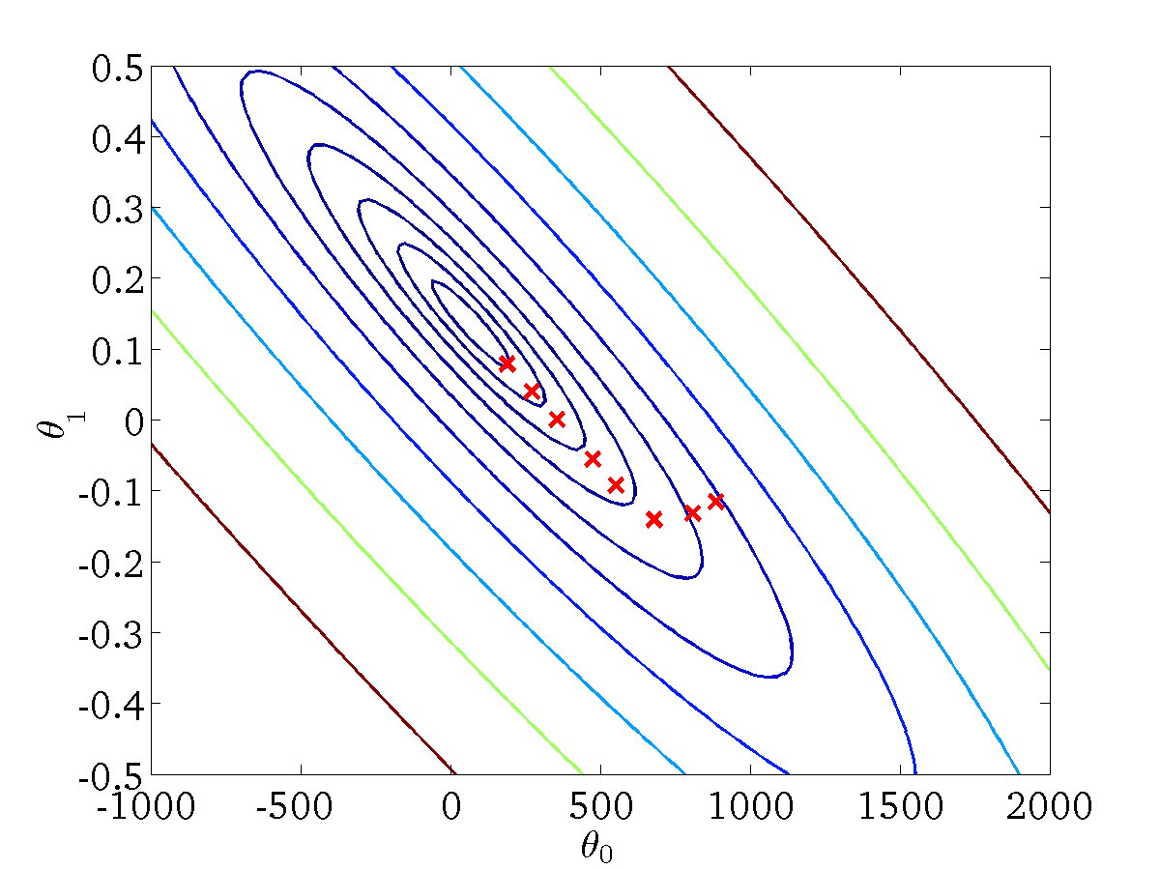
(for fixed , this is a function of x)
(function of the parameters )

Slide 22
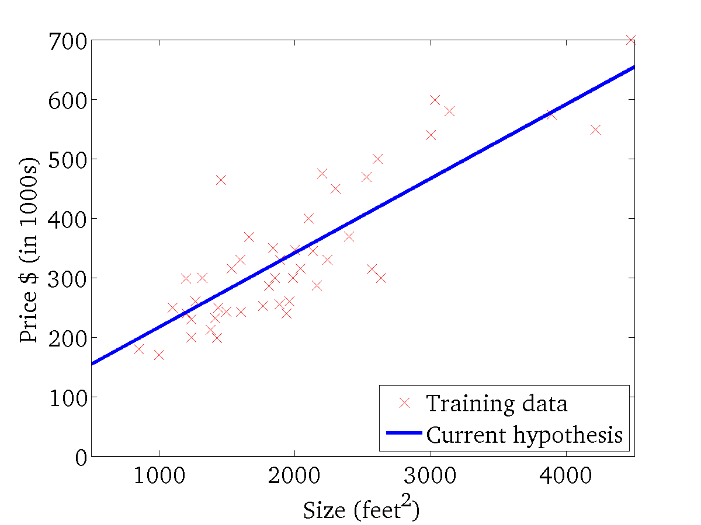

(for fixed , this is a function of x)
(function of the parameters )

Slide 23
“Batch” Gradient Descent
“Batch”: Each step of gradient descent uses all the training examples.

